Slide 1
2018 Research Forum #SAA18RF
Welcome to the 12TH Annual

Slide 2
Thank you’s
#SAA18RF
SAA Staff
Research Forum Program Committee
Research Forum Coordinators
– Tricia Patterson
– Greta Suiter

Slide 3
2018 RF Program Committee
#SAA18RF
Carolyn Hank
Ardys Kozbial
Nance McGovern (co-chair/co-founder)
Gabby Redwine
Kari Smith
Heather Soyka (co-chair)
Helen Tibbo (co-founder)

Slide 4
2018 RF Presenters
#SAA18RF
Platform Slides
please load your slides into your session folder on the presentation laptop during the break before your session or during lunch
Poster Images
Please put your poster image into the posters folder on the desktop of the presentation laptop (or email it to Tricia…)

Slide 5
Agenda
#SAA18RF
Printed copies of the agenda are available
full (and correct) version online
Abstracts and bios are available (as usual) on the Research Forum website for 2018
Slides and poster images will be added to the website as soon as we can …

Slide 6
Proceedings
#SAA18RF
Slides and poster images will be added to the website within the next few weeks
Search box for the Proceedings
Thanks to Matt Black!

Slide 7
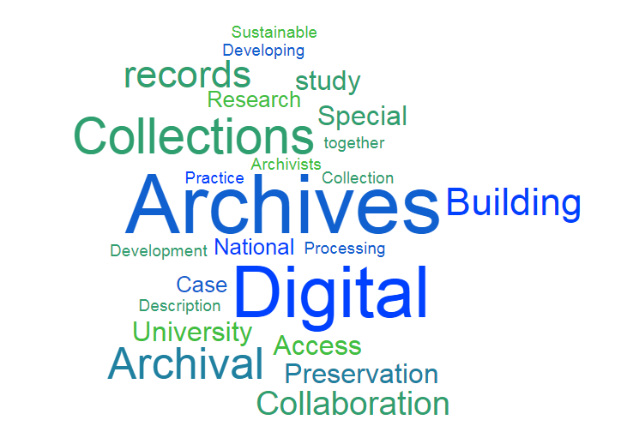
#SAA18RF

Slide 8
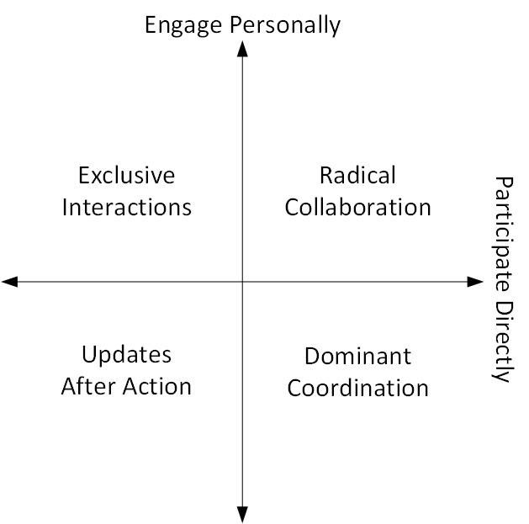
Watch This Space….
#SAA18RF
Special Issue of RLI (Research Library Issues) on Radical Collaboration, coming Fall 2018
working together across domains
focus on research data
archivists contributing
professional inclusion
convening at a roundtable
ARL Archives and Libraries

